Slide 1
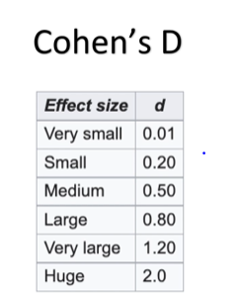
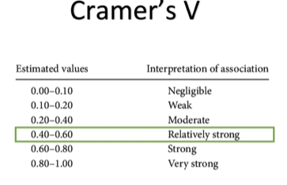
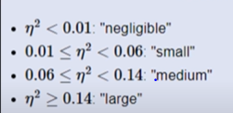


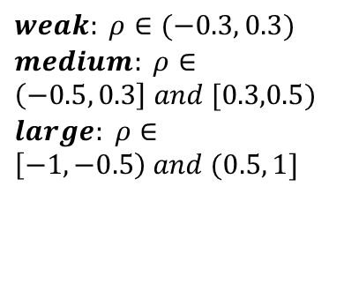
Summary of effect sizes
$$χ^{2}$$
Correlation
Independent samples or paired samples T-test
ANOVA
$Pearson R (ρ$)
$weak: ρ∈(−0.3, 0.3)$
$medium: ρ∈\left(−0.5, 0.3\right] and [0.3,0.5)$
$large: ρ∈\left[−1,−0.5\right) and (0.5, 1]$

